Slide 1

Hotel booking system
Presentation
11/10/2024

Slide 2

Agenda
BACKGROUND
PROJECT METHODOLOGY
PROJECT STACK
DEMOS
LESSONS LEARNED

Slide 3

BACKGROUND
MEET THE TEAM
Three full-stack Developers:
LANGELIHLE MHLONGO (Team Lead)
KATLEGO CHOPO
LUTHANDO JAYIYA

Slide 4

BACKGROUND
PROJECT PURPOSE
Our digital agency has identified a need in the market for providing a hotel management and booking system as a paid for service.
This will be targeted at both larger hotel chains and small individual hotel owners.

Slide 5
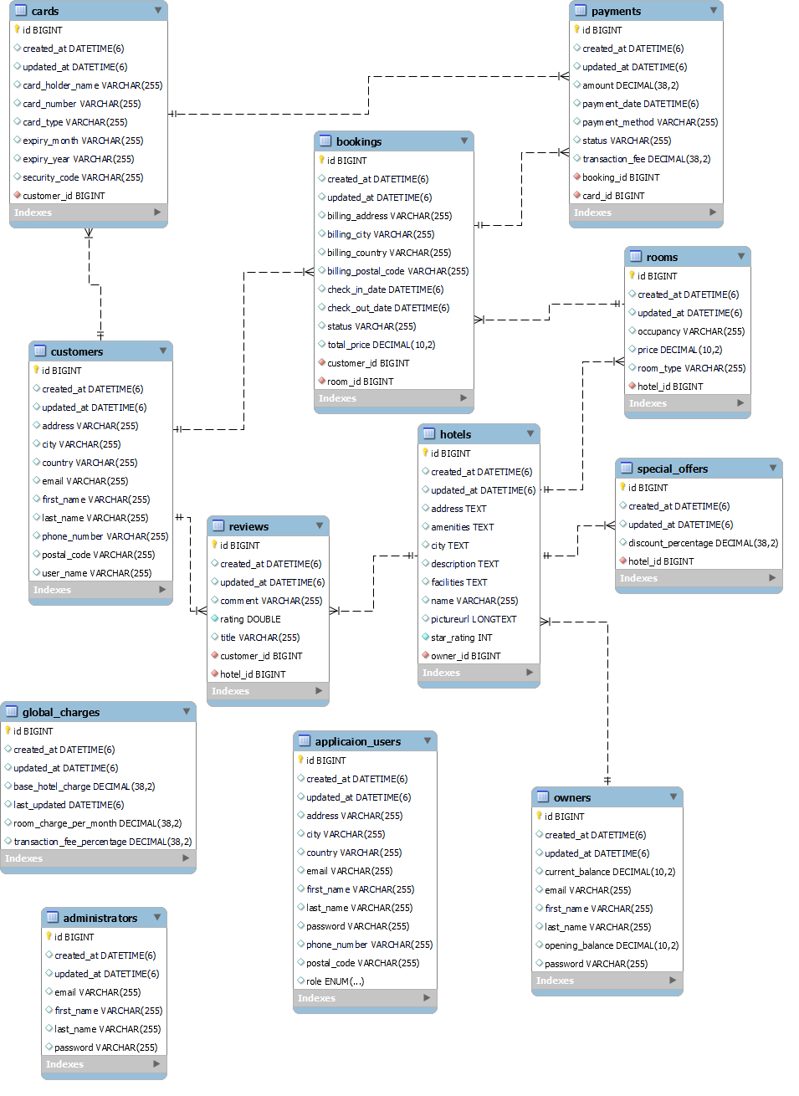
BACKGROUND
PROJECT PURPOSE
Three main actors:
Administrator
Hotel Owner
Customer
CRUD operations involved for each actor

Slide 6
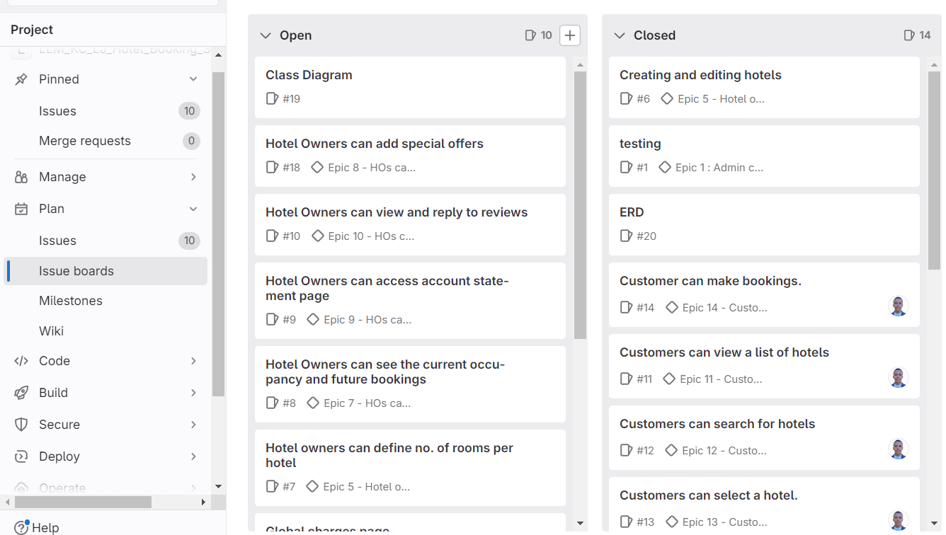
PROJECT METHODOLOGY
AGILE
Sprint planning
Daily Scrum
Kanban board
Code Reviews

Slide 7

PROJECT STACK
PROJECT TOOLS
BACK-END:
MySQL
JAVA 17
SPRINGBOOT
SPRING DATA JPA
SPRINGBOOK SECURITY
HIBERNATE
SWAGGER
POSTMAN
JUNIT AND MOCKITO
GIT

Slide 8

PROJECT STACK
PROJECT TOOLS
FRONT-END:
REACT + VITE
HTML / CSS
JavaScript
NPM / YARN
AXIOS
GIT

Slide 9
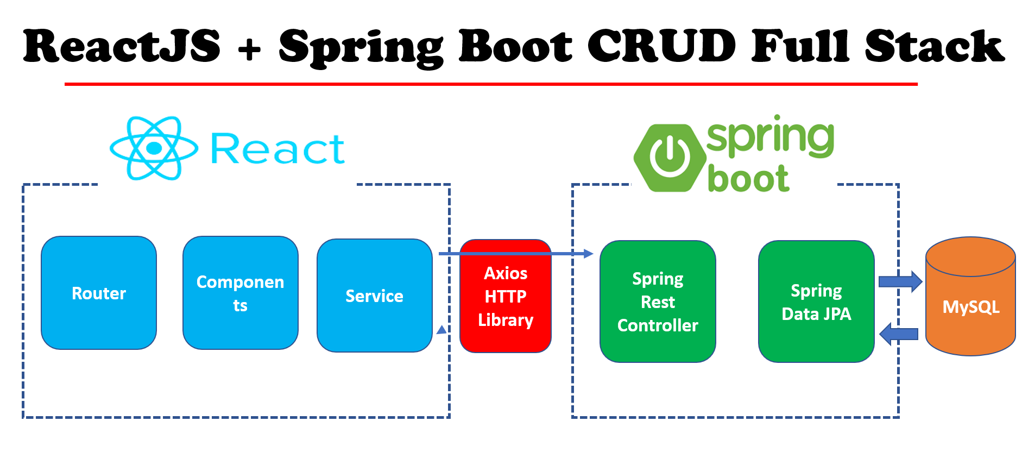

Slide 10


Slide 11

LeSSONS LEARNED
FUTURE IMPROVEMENTS
Better broken-down user stories
Better communication between the team on tasks taken
Frequent Code Reviews and Quality check
Better organisation and task delegation

Slide 12
THANK YOU
ANY QUESTIONS?

